Slide 1
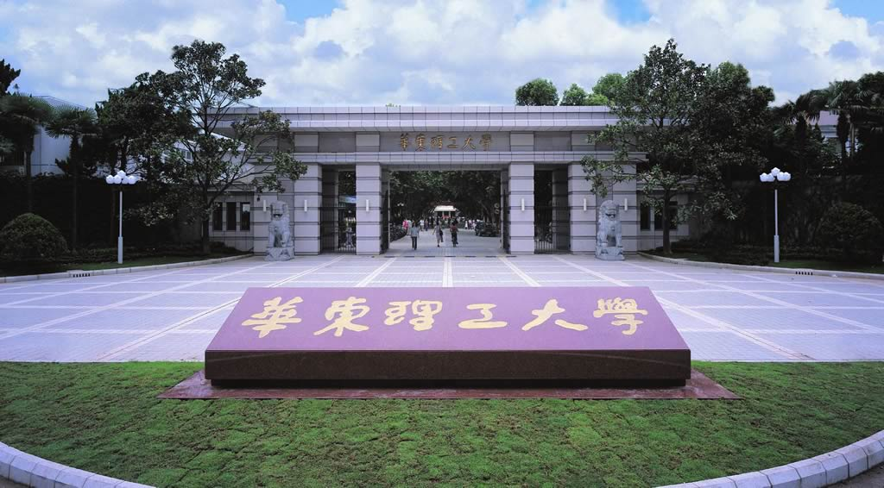
Chapter 2
Expression proteomics
--Sample preparation

Slide 2
Proteomics
Proteomics analyzes the structure and function of biological systems
It is the systematic, large-scale analysis of protein’s
Expression levels
Post-translational modifications (PTM)
Activities (function)
Location
Interactions (complex formation), etc
Notes:
pGlyco 2.0 enables precision N-glycoproteomics with comprehensive quality control and one-step mass spectrometry for intact glycopeptide identification

Slide 3
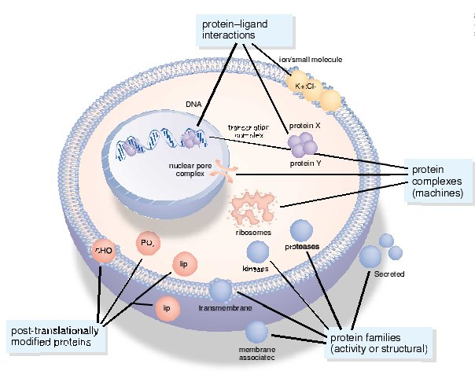
Proteome study
Detection
What and where
PTM
Quantification
compare dynamics
Function
interaction with each other
Notes:
阐明生命细胞代谢，信号传导和调控网络的组织结构和动力学，并理解这些网络是如何在病理或生理镇南关执行功能，又如何通过干预（如药物和基因）改变他们的功能

Slide 4

Proteome Study Workflow
Sample preparation
Sample separation
Protein identification
Protein quantification
Protein function/protein interactions assay

Slide 5
Sample preparation
Sample preparation is the first and key step for successful proteome study
It is difficult because
Too many different kinds of proteins
Different expression abundance
Different character

Slide 6
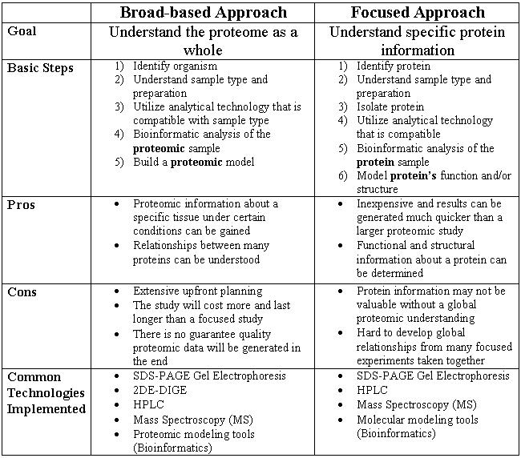

Slide 7



Sample Preparation Method(s) Selection
According to the goal (Try the best to get the need proteins)
broad-based approach--As many kinds of proteins as possible
focused approach--Only some interested proteins
Should consider the combination with later separation method
2DE: the amount of SDS
HPLC: the amount of detergents/ampholytes

Slide 8


High heterogeneity No universal method Need to be optimized for each sample
Sample preparation
General recommendations
Keep it simple to increase reproducibility
Notes:
Universal proteomics sample preparation is challenging due to the high heterogeneity of biological samples

Slide 9
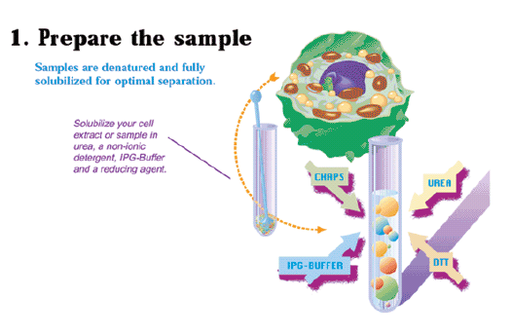

2.1 Principle for Sample Preparation
Broad-based approach
Thorough, consistent method resulting in complete solubilisation, disaggregation, denaturation and reduction of all proteins

Slide 10
Basic principles
Keep it simple to increase reproducibility
Minimize possibility of protein losses and modifications
Keep sample treatment by a minimum step
Keep sample as cold as possible
Protease degradation
Carbamylation modification by urea over 37C
Keep treating time as short as possible
Break all non-covalent protein-protein, protein-DNA, protein-lipid interactions, disrupt S-S bonds to keep protein uniform

Slide 11

Basic principles
Prevent proteolysis, accidental phosphorlation, oxidation, cleavage, de-amidetion
Remove substances that might interfere with separation process such as salts, polar detergents (SDS), lipids, polysaccharides, nucleic acids
Denature the sample and try to keep proteins soluble during both phases of electrophoresis process
Divided into small parts and stored at - 80C after preparation, avoid freezing and thawing repeatly

Slide 12




Focused approach
--Get partical interested proteins
Remove the interfance of high abundance proteins
Avoid protein losses and modification
Avoid interfance of non-protein compents
Keep all sample soluble

Slide 13
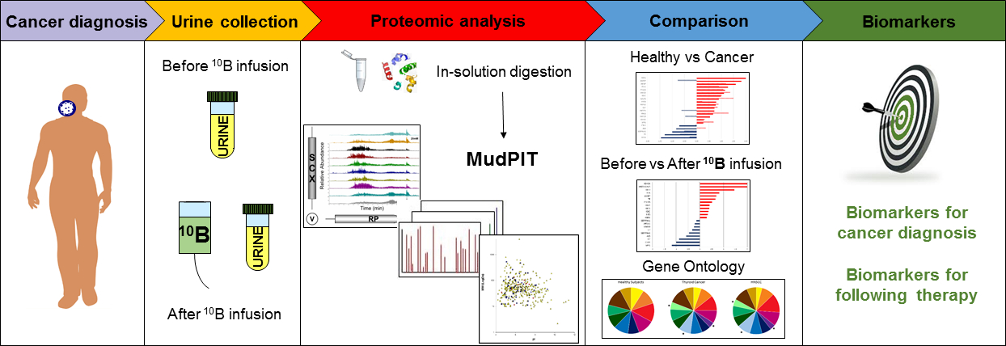
2.2 Steps for sample preparation ---biofluids
Body fluid is liquid originating from inside the bodies of living people
sample collection-->interactions removal-->contaminant removal

Slide 14
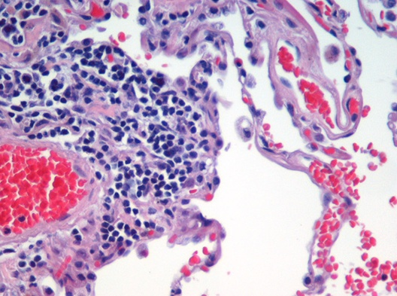
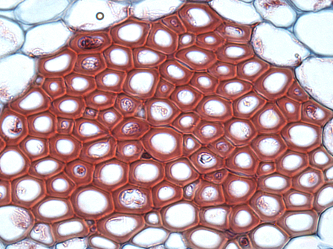



2.2 Steps for sample preparation --cell or tissue
Cell Disruption
Protein Solublization
Interactions Removal
Contaminant Removal

Slide 15
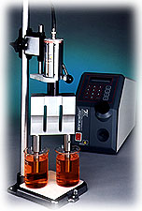





1 Cell Disruption
Vigorous Methods
Sonication
French press
Glass bead disruption
Enzymatic lysis
Detergent lysis
Freeze-thaw
Osmotic lysis
Gentle Methods

Slide 16
2 Extract and lyse Proteins
Extract proteins
Make protein soluble
Separate protein from non-protein components
Salting-out
TCA percipitation
Organic solvent precipitation
etc
Lyse proteins—make proteins free
Disrubt interactions among proteins and other non-protein components
Denature and reduce proteins
Remove non-protein components

Slide 17






Function of “Lysis Buffer”
Convert proteins into single conformations
Avoid different oxidation steps
Prevent protein from aggregation
Prevent protein from being modified
Get hydrophobic proteins into solution and keep them in solution
Deactivate proteases
Cleave disulfide bonds and hydrogen bonds; uncoil the polypeptides to expose all buffering groups to the medium

Slide 18
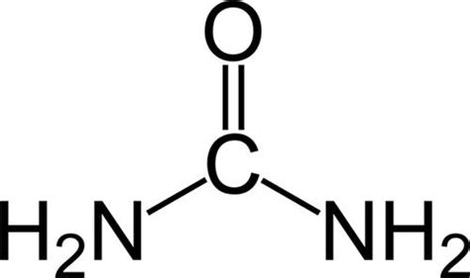
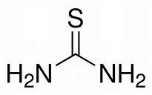
Composition of “Lysis buffer”
Chaotrope /denature reagent
Change or disrupt the noncovalent bond or hydrogen bond among the secondary/ tertiary structure of proteins to denature proteins, avoid aggregation and inactive protease.
Main components:
Urea, Thiourea
Usually 2M Thiourea + 5-8M urea
More than 1h, lower than 30℃ (avoid Urea hydrolsis to cyanate and protein modification)
Notes:
of proteins,espically membrane proteins;break down hydrophobic bonds to avoid aggregation
Urea:与蛋白质的半胱氨酸竞争结合碘代乙酰胺，使蛋白质烷基化不完全
硫脲：抑制SDS与蛋白的结合，增加脂类的溶解性，使等点聚焦酸性pH范围分辨率降低

Slide 19
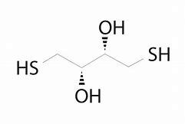
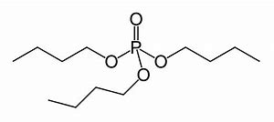
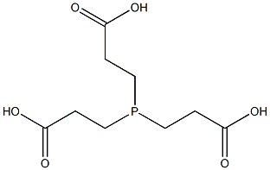


Reducing reagent
Disrupt disulfide bonds among proteins to increase protein solubility
Prevent different oxidation steps of proteins
Main components
β-ME (β-巯基乙醇)
DTT (二硫苏糖醇)-ionic
DTE (二硫赤藓糖醇)--ionic
TBP ( 三丁基膦)– non-ionic
TCEP(三羧基乙基膦)
What's the problem of ionic reducing reagent?

Slide 20
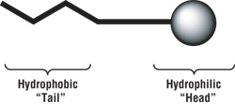
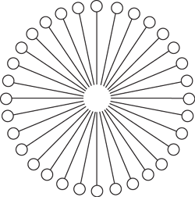

Detergent
a class of amphipathic molecules whose unique properties enable manipulation (disruption or formation) of hydrophobic–hydrophilic interactions among molecules in biological samples
At low concentration in aqueous solution, detergents form a monolayer at the air–liquid interface.
At higher concentrations, detergent monomers aggregate into structures called micelles(胶束).
Detergents can be denaturing or non-denaturing with respect to protein structure.

Slide 21


Detergent
Three types
Zwitterionic detergent (having both positively and negatively charged groups but with a net charge of zero)
CHAPS, CHAPSO，SB3-10（3-(癸基二甲基铵)丙烷-1-磺酸内盐）, ASB-14(酰胺硫代甜菜碱), Zwittergent, OBG
Nonionic detergent (uncharged)
Triton X-100, Triton X-114, Tween-20 , Nonidet NP-40, OG(辛葡糖苷) etc
Ionic detergent (charged, either anionic or cationic)
SDS, CTAB, etc

Slide 22
Detergent
uses in biological research
lyse cells (release soluble proteins)
solubilize membrane proteins and lipids
control protein crystallization
prevent nonspecific binding in affinity purification and immunoassay procedures,
as additives in electrophoresis
uses in lysis buffer
Break down hydrophobic interactions and increase the solubility of proteins
Extraction and solubilization of membrane proteins

Slide 23

Carrier Ampholytes
Carrier Ampholytes are small, soluble molecules with both positive and negative charge groups. They sort based on their isoelectric points in an electric field, thereby establishing a pH gradient in solution or contributing to the gradient when used with IPG strips.
Function
Keep pH and increase protein solubility
Decrease protein aggregation because of ionic interaction
Absorb CN⁻ produced by high concentration of urea, so decrease the possiblility of modification
Usually used concentration: 2%

Slide 24




Composition of standard “Lysis buffer”
8 mole/L Urea
4% CHAPS
1% DTT
0.8% Carrier ampholyte
0.002% bromophenol blue

Slide 25

Typical step
Tissue frozen
Add five volume lysis buffer (1%(m/v) SDS, 5%(m/v) B-ME or DTT, 2M thiourea, 5M urea）
Homogenation
Centrifugation at 4℃ 1000gX 10 min, get the upper part
Recentrifugation at 10500g for 30 min, get the precipe
Resolve in 1%(m/v) SDS, 5%(m/v) B-ME
Centrifugation at 4℃ 8000g X 5 min
Dilute before loading for electrophoresis

Slide 26


Lysis buffer
Ahaotropic agent | disrupt hydrogen bonds denaturing and solubilising | urea, or a combination of urea and thiourea
Detergent | Increase the solubility of hydrophobic proteins | NP-40
Reducing agent | Prevent different oxidation | Charged: Dithiothreitol (DTT) β-mercaptoethanol Noncharged: tributyl phosphine(TBP)
Ampholytes | representing the desired pH range, uniform conductivity, solubilising
Dye | Control starting and running condition | Bromophenol blue
Protease inhibitors | inhibit protease activities | PMSF (8mM) Pefabloc (AEBSF) (5-10mM) Protease “cocktails”
Alkaline conditions | Maximize protein extraction Precipitate nucleic acid Keep protease activity low | Tris base 40mM Spermine base 25mM

Slide 27


3 Proteolysis and degradation Protection
Low temperature
Protease inhibitors
PMSF( phenylmethylsulfonyl fluoride)--serine protease inhibitor
Pefabloc (AEBSF)--irreversible serine protease inhibitor
Leupeptin (N-acetyl-L-leucyl-L-leucyl-L-argininal 亮肽素)--serine, cysteine and threonine proteases inhibitor
Metal chelators
EDTA (Ethylene diamine tetraacetic acid)
EGTA (ethylene glycol tetraacetic acid)
Detergent

Slide 28

4 Contaminant Removal
Contaminants:
Solid materials
Salt ions
Small molecules
Phosphlipids/lipids
Nucleic acids
SP2: Rapid and Automatable Contaminant Removal from Peptide Samples for Proteomic Analyses J. Proteome Res.,
DOI: 10.1021/acs.jproteome.8b00916
Notes:
小离子分子: 研究材料本身,如组织中的代谢物和血清中的无机盐,或者在制备样品时作为添加剂的成份:如缓冲液\无机盐,离子去垢剂等
干扰等电聚焦:1)盐离子可导致溶液的电导率增大,延长等电聚焦时间,直到离子移至胶条末端时聚焦才完成. 2)盐积聚在胶条内的阳极或阴极端,产生高传导性区域,使蛋白质不能在此处聚焦(如出现水平条纹),离子去垢剂SDS与多肽形成复合物,干扰正常聚焦
盐的去除:透析,旋转透析,凝胶过滤,沉淀/重悬浮等,或在初始步骤就采用低离子强度的洗涤溶液来解决,如Tris-山梨醇缓冲液.对SDS的去除,可采用兼性离子去垢剂或非离子型去垢剂的重泡胀溶液稀释含SDS的样品或加入丙酮并在高温下沉淀蛋白质
核酸:导致IEF酸性区难以聚焦;如果对双向电泳进行银染,核酸会产生高背景;DNA的存在使样品粘性太高,阻滞凝胶孔径.
清除方法:使用RNase,和DNase,但该两种酶也可能出现在双向电泳图像中, 可用Benzonase*细菌特异性内源DNA和RNA核酸酶解决; 超速离心去除大分子核,但高质量蛋白质也可能被去除;高离子强度或高pH提取溶液减少核酸的干扰.
多糖: 阻碍凝胶孔径,导致蛋白沉淀,延长聚焦时间,有时也会出现水平条纹;某些多糖含负电荷,能与蛋白形成复合物. 通常硫酸铵沉淀或苯酚/乙酸方法进行沉淀,随后离心; 超速离心

Slide 29


Techniques
Dialysis
Electrophortic desalting
Filtration
Centrifugation
Chromatography
Solvent Extraction

Slide 30





Method
Nucleic acids
DNase/RNase, Benzonase, sonication, ultracentrifugation, high concentration or high pH buffer
Lipid
excess of detergent(>2%), Precipatation
Polysaccharide
Salting out, phenol-acetic acid precipatation, ultracentrifugation
Solid materials
Centrifugation,filtration
Small molecules (including salt)
dialysis, precipatation, gel-filtration chromotography

Slide 31
Exercise Tell the goal and design suitable sample preparation method
Optimization of sample preparation for transporter protein quantification in tissues by LC–MS/MS
Two-Dimensional Biochemical Purification for Global Proteomic Analysis of Macromolecular Protein Complexes
Urinary Proteomics Profiles Are Useful for Detection of Cancer Biomarkers and Changes Induced by Therapeutic Procedures
Proteomic Detection of Carbohydrate-Active Enzymes (CAZymes) in Microbial Secretomes
Proteomics in the Study of Liver Diseases
Notes:
SP2: Rapid and Automatable Contaminant Removal from Peptide Samples for Proteomic Analyses

Slide 32
2.3 Sample Pre-Fractionation
One-step extraction
extremely complex with a large dynamic range of abundance
extraction capacity is limited，usually only results in about 50% protein
Pre-Fractionation
isolate groups of proteins, or fractions from total proteome
simplify analysis of complex protein mixture
provide less crowded 2DE map
improve resolution when an individual fraction is analyzed

Slide 33





2.3 Sample Pre-Fractionation
Pre-Fractionation
According to protein solubility
Sequential extraction
According to protein location
Centrifugation
According to abundance
Affinity chromatography
According to pI
etc

Slide 34

2.3.1 Sequential extraction based on solubility
Protein sample
Extraction with
40mM Tris Base
supernatent
pellet
Fraction 1
Extraction with
8M Urea, 4% CHAPS
supernatent
pellet
Fraction 2
Extraction with
5M Urea, 2M Thiourea
2% CHAPS, 2% SB3
supernatent
pellet
Extract with SDS
Fraction 3
Fraction 4

Slide 35
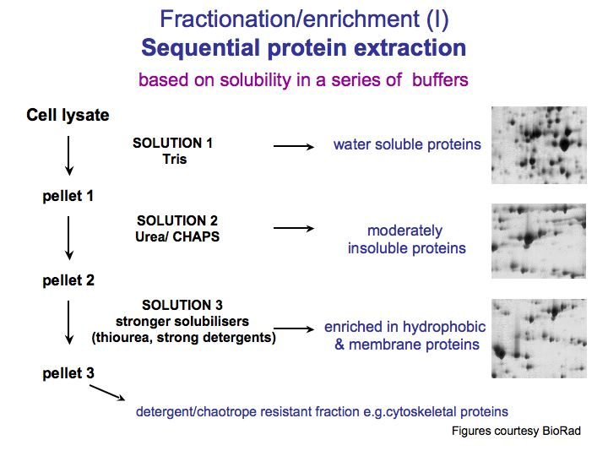

Slide 36
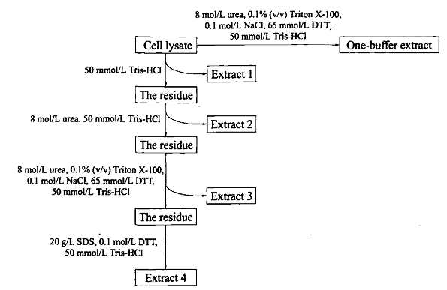
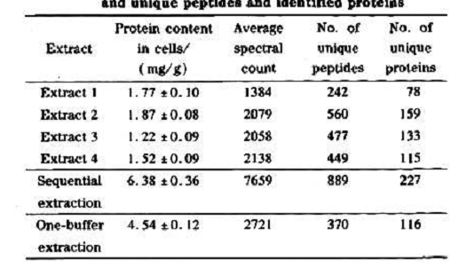

L. Starkeyi 斯达氏油脂酵母
合成大量油脂，影响蛋白抽提和后续蛋白组学研究
Sequential extraction leading to improved proteomic
analysis of the oleaginous yeast, Lipomyces Starkeyi
Chinese Journal of Chromatography, 2011,29(5):382-388
Advantage：
More protein spots
Increase low-abundant protein detection ratio

Slide 37

2.3.2 Subcellular Fractionation
Allows access to intracellular organelles and multi-protein complexes
Enrichment of low abundant proteins and signaling complexes
Reduce sample complexity
According to different physical properties of subcellular organelles

Slide 38
Detergent Fractionation
Cells
Extraction with
Digitonin/EDTA
supernatant
pellet
Cytoplasmic
Fraction
Extraction with
TritonX100/EDTA
supernatant
pellet
Organelle
Membranes
Extraction with
SDS/EDTA
supernatant
pellet
Nuclear
Cytoskeletal (in SDS)
Notes:
Digitonin 毛地黄皂苷 supernatant 上清 supernant 浸液

Slide 39
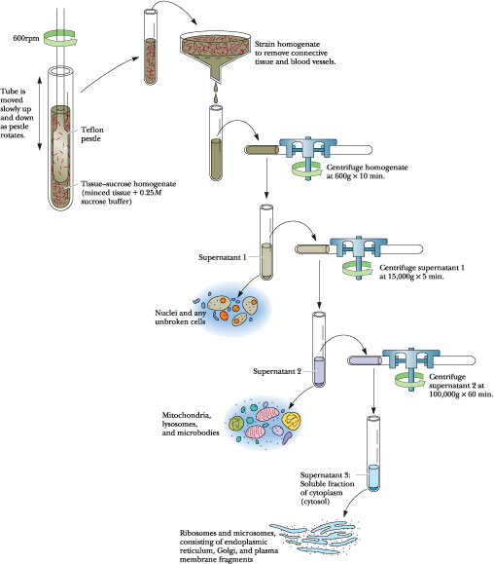
Differential centrifugation
Separation is based on size and density, with larger and denser particles pelleting at lower centrifugal forces.

Slide 40
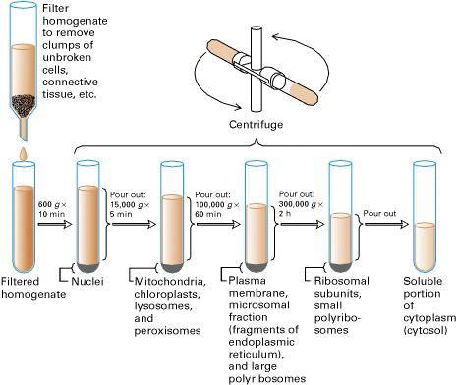

Slide 41
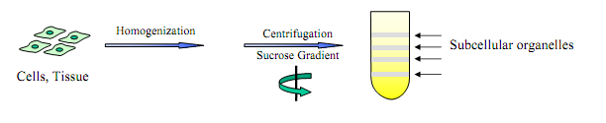
Density gradient centrifugation
a technique that allows the separation of cells, organelles and macromolecules, depending on their size, shape and density.
When mixtures of cellular extracts are layered on top of a density gradient in a tube and subjected to centrifugation, the various components move through the gradient at different rates that are dependant on their sizes and shapes.

Slide 42
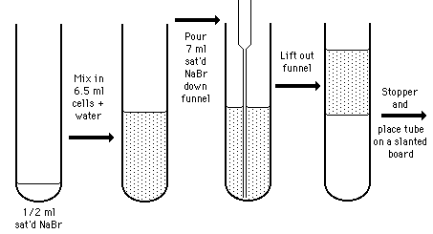
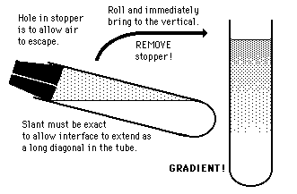
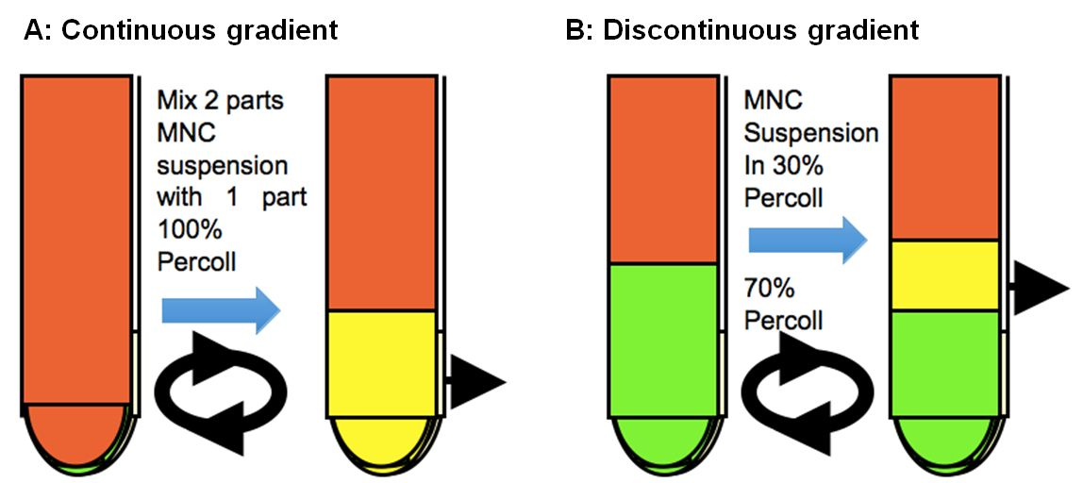
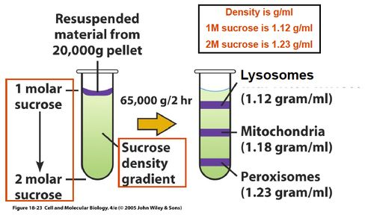

Slide 43
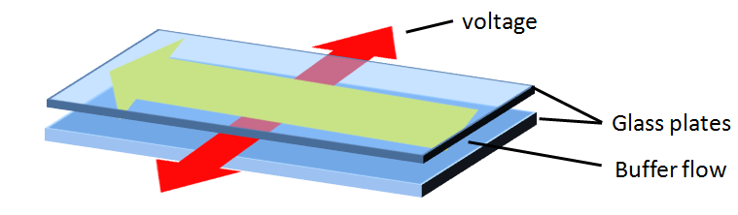
Free-flow electrophoresis (FFE)
Also known as carrier-free electrophoresis, is a matrix-free electrophoretic separation technique
An analogous technique to capillary electrophoresis, with a comparable resolution, that can used for semi-preparative and preparative sample separation
It is used to quantitatively separate samples according to differences in charge or isoelectric point
It is used for protein enrichment, especially suited for complex protein mixtures, isolation of subcellular compartments (like organelles, ribosomes) or pre-fractionation of complex protein mixtures using narrow pH gradients
Notes:
The advantage of FFE is the fast and gentle separation of samples dissolved in a liquid solvent without any need of a matrix, like polyacrylamide in gel electrophoresis. T

Slide 44
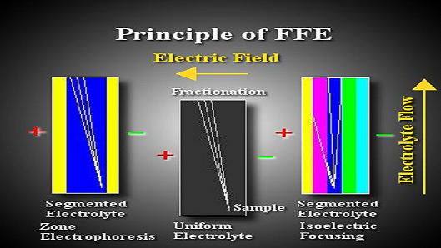
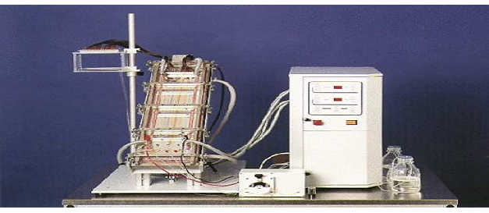

Slide 45
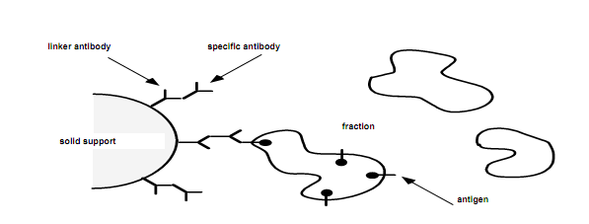
Immunoisolation
Organelles are separated with antibodies according to their antigenic properties, rather than their physical properties
Is most efficiently combined with density gradient centrifugation as means for prefractionation
principle

Slide 46
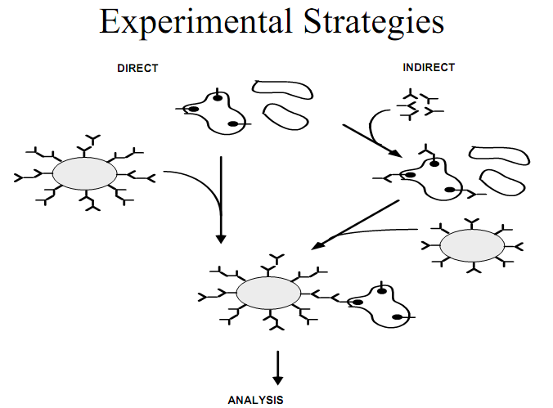

Slide 47

Fluorescence Activated Organelle Sorting (FAOS)
Flow cytometry was adapted to sort and analyze intracellular organelles after labeling with fluorescent dyes.
Conventional subcellular fractionation techniques was combined with high speed organelle sorting in a FACS.

Slide 48
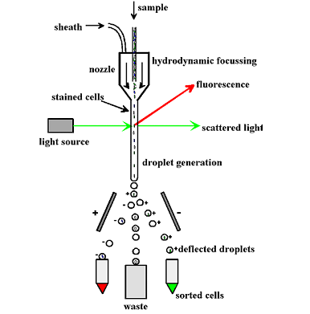
Principle
Labeling intracellular organelles, e.g. mitochondria, Golgi, ER, plasma membrane, phagosomes, endosomes, with fluorescent membrane dyes or fluorescently labeled ligands, allows purification due to biological properties rather than physical densities

Slide 49
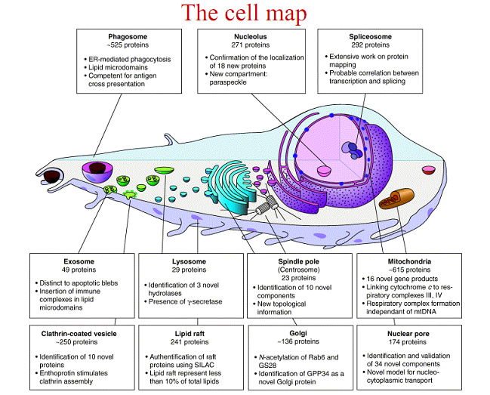

Slide 50
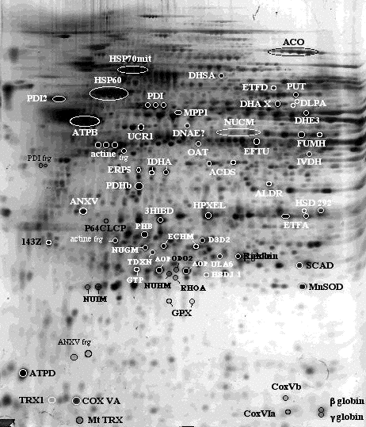
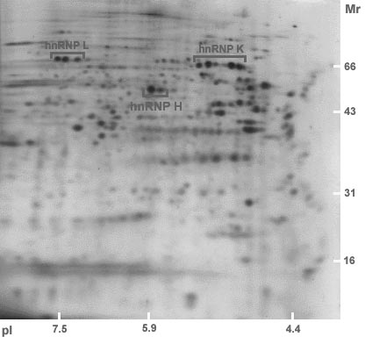
Different cellular compartments
Human mitochondrial proteins
Human nuclear proteins

Slide 51

2.4 Special sample preparation
Body fluid (Serum, plasma, urine, CSF, BAL, saliva, tears etc)—include many secretory proteins
Secretory protein
Any protein, whether it be endocrine or exocrine, which is secreted by a cell.
Include many hormones, enzymes, toxins, and antimicrobial peptides.
involved in a variety of physiological processes, including cell signaling and matrix remodeling, but are also integral to invasion and metastasis of malignant cells

Slide 52
Challenges
Contaminants
In culture, cells are surrounded by contaminants
Bovine serum from cell culture media and cellular debris
Many bovine extracellular proteins, like fibronectin and fibulin-1, are similar to the human protein sequences.
Low concentration
Some proteins are secreted in low abundance and then diluted further in the cell culture medium or body fluid
Blocked by high abundant proteins(e.g. plasma, serum)
Methods
Concentrate
Desalt
Remove high abundant proteins
Notes:
Fibulin 纤蛋白
Fibronectin纤连蛋白

Slide 53
Cell and tissue samples
Usually disrupted and solubilised in lysis buffer
Solubilisation
Disrupt all non-covalently bound protein complexes and aggregates into a solution of individual polypeptides
Chaotrope + Detergent + Reducing agent (9.5 M urea, 4% NP-40, 1% DTT)
Notes:
fibronectin
纤连蛋白

Slide 54

Challenges
heterogeneity （异质性）
Tumor tissues contain various types of non-tumor cells such as normal counterpart cells, vascular endothelial cells, and inflammatory cells.
the vascular structures in the tumor tissues may include plasma, which contains large amounts of plasma proteins
Methods
Laser microdissection（LMD）
first reported in 1996

Slide 55
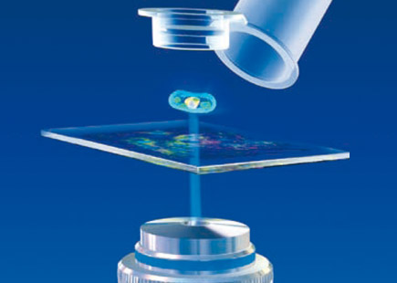
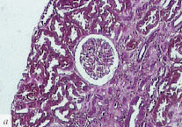
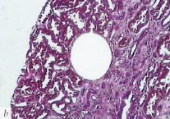
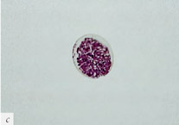
Laser microdissection（LMD）
Also called Laser capture microdissection(LCMD), Microdissection, Laser-assisted microdissection (LAD)
A method for isolating specific cells of interest from microscopic regions of tissue/cells/ organisms
By a precisely controlled laser pulse the selected specimen is ejected vertically out of the object plane and into a collection device – against the force of gravity.
Notes:
Laser-capture microdissection (LCM) is a method to procure subpopulations of tissue cells under direct microscopic visualization. LCM technology can harvest the cells of interest directly or can isolate specific cells by cutting away unwanted cells to give histologically pure enriched cell populations.

Slide 56
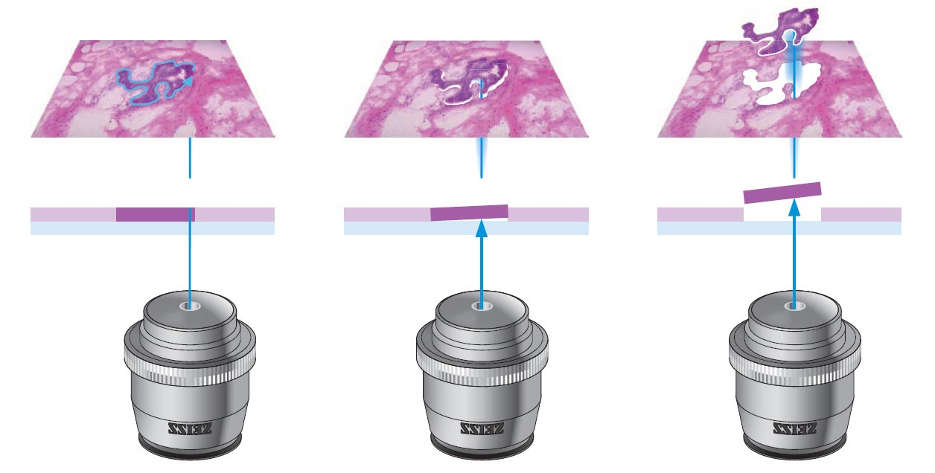

Slide 57

Low abundance proteins
Usually have important function
Increase the initial amount of protein source or increase the solubility of proteins, the amount of high-abundance protein will increase too, which interference later sample separation
Pre-purification
Enrich
Remove high-abundance protein

Slide 58
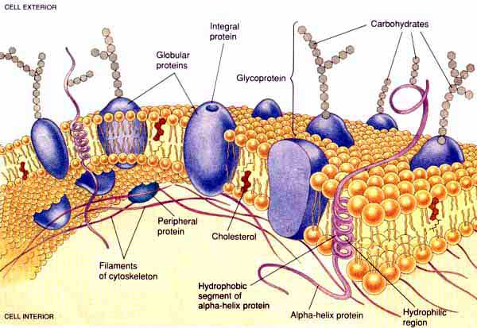

Membrane proteins:
Protein molecule that is attached to, or associated with the membrane of a cell or an organelle
Comprise approximately 30% of the eukaryotic proteome and are a key target in drug discovery research
Difficult to isolate, soluble and appear in 2DE，because of their hydrophobicity, basic nature（high-pI） and large size，usually low abundance
Method
stronger detergents, such as CHAPS
selectively enriching the initial sample e.g. preparing membrane fractions
Notes:
为了能够在二维凝胶图谱中，首先必须实现3个条件：
（1）保持膜的脂类环境；
（2）以可溶形式（去污剂－蛋白复合物）从膜上
分离出来；
（3）所提取的膜蛋白必须维持可溶状态。

Slide 59
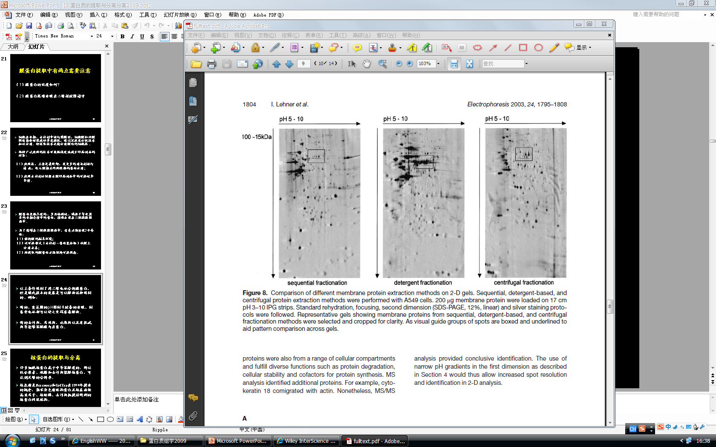
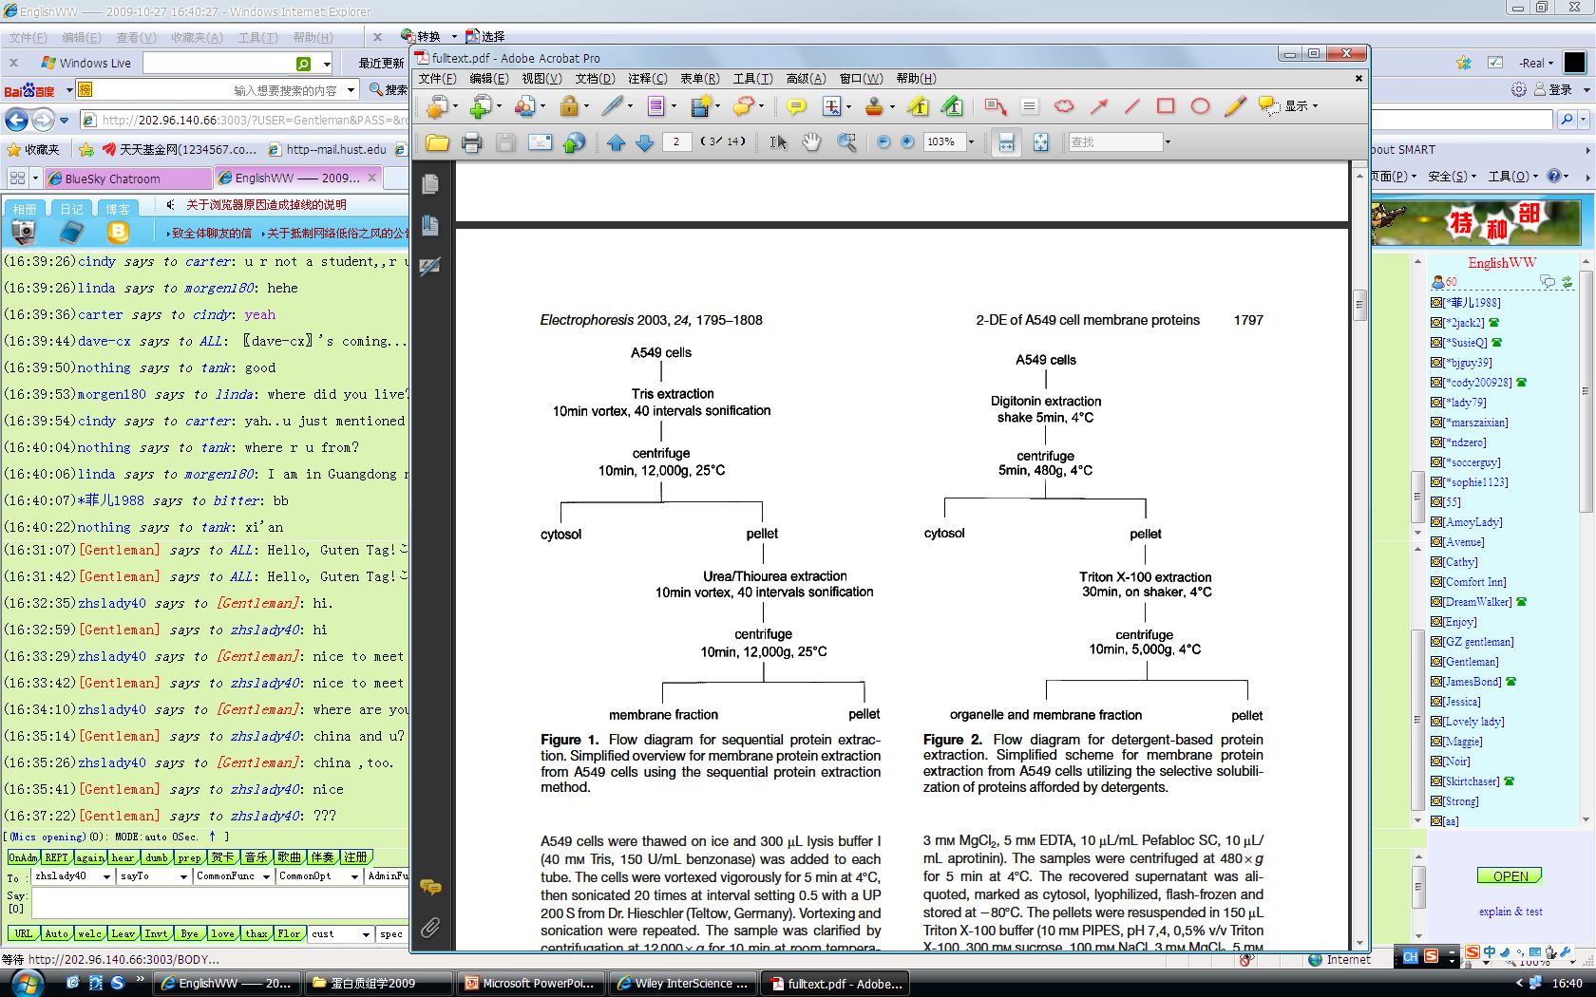

Slide 60
Question
The preparation of good nuclear protein extracts is central to the success of many gene regulation studies.
Please give the method for nuclear protein preparation

Slide 61
2.5 Protein concentration assay
A280 Absorbance Assay
No additional reagents or incubations are required
Amino acids with aromatic rings are the primary reason for the absorbance peak at 280 nm.
Concentration (mg/ml) = (1.55 x A280) - 0.76 x A260)
Limitation?

Slide 62
Lowry protein assay
A biochemical assay for determining the total level of protein in a solution
The method combines the reactions of copper ions with the peptide bonds under alkaline conditions (the Biuret test) with the oxidation of aromatic protein residues.
Involves reduction of the Folin reagent and oxidation of aromatic residues (mainly tryptophan, also tyrosine)
The result of this reaction is an intense blue molecule known as heteropolymolybdenum Blue
Messure the absorbance at 660 nm
Best used with protein concentrations of 0.01-1.0 mg/mL.
The Bicinchoninic acid (BCA) assay and the Hartree–Lowry assay are subsequent modifications of the original Lowry procedure.

Slide 63
BCA assay
Also known as the Smith assay, a biochemical assay for determining the total concentration of protein in a solution (0.5 μg/mL to 1.5 mg/mL)
A two-step assay, in which Cu²⁺ is first reduced to Cu¹⁺ forming a complex with protein amide bonds (Biuret reaction). Secondly, bicinchoninic acid (BCA) forms a purple complex with Cu¹⁺ which is detectable at 562nm.
The total protein concentration is exhibited by a color change of the sample solution from green to purple in proportion to protein concentration
Reagent A: 1g bicinchoninate (BCA), 2g sodium carbonate, 0.16g sodium tartrate, 0.4g NaOH, 0.95g sodium bicarbonate. -Mix reagents in 80ml distilled water, adjust pH to 11.25 with 8M NaOH, and make solution up to 100ml. Reagent B: 4% CuSO4.5H2O (4 g in 10 ml distilled water)
Working solution (WS): Mix 50 volumes of Reagent A with 1 volume of Reagent B. This green working solution is stable for 1 week.

Slide 64
Bradford assay
Developed by Marion M. Bradford in 1976
A colorimetric protein assay based on an absorbance shift of the dye Coomassie Brilliant Blue G-250.
The Coomassie Brilliant Blue G-250 dye exists in three forms: anionic (blue), neutral (green), and cationic (red)
In this assay, the red form of the dye under acidic conditions is converted into its blue form to bind to the protein being assayed
If there's no protein to bind, then the solution will remain brown
The increase of absorbance at 595 nm is proportional to the amount of bound dye, and thus to the amount (concentration) of protein present in the sample.
Typical range: 0 µg/ml to 2000 µg/ml

Slide 65
Questions
What are the processes involved in the preparation of protein samples? What is the meaning of each process?
What are the purposes and principles of protein sample preparation?
Why should some inhibitors be added in the preparation of protein samples?
Why do we do sample pre-fraction?
What are the main components in protein lysis buffer? What are the representatives and roles of each component?
How to improve the separation and purification efficiency of hydrophobic proteins (low abundance proteins, biofluids, etc) ?

Slide 66
Questions
蛋白质样品的制备有哪些过程？各个过程的意义是什么？
蛋白质样品制备的目的和原则各是什么？
蛋白质样品的制备过程中为什么要加入某些抑制剂？
为什么要进行样品预分级？
蛋白裂解液的主要成分有哪些，各有何代表，作用是什么？
如何提高疏水蛋白(低丰度蛋白、生物流体、外泌体、极高或极低pI的蛋白质等）的分离和纯化效率？

